Slide 1
Introduction to Macro Economics
Professor Syed A. Mamun, PhD, FCMA
Professor of Finance
Department of ESS

Slide 2
What is Economics
Economics is the study of how individuals, businesses, and governments allocate scarce resources to satisfy unlimited wants.
Economics is broadly divided into two branches:
Microeconomics | Macroeconomics
Studies individual consumers, firms, and markets | Studies the economy as a whole
Price of a product | General price level (inflation)
Demand and supply of a product | National income and output
Individual firm decisions | Government economic policies

Slide 3
Example
Microeconomics: Why did the price of rice increase?
Macroeconomics: Why is the overall inflation rate increasing in Bangladesh?

Slide 4
What is macro economics?
According to economist N. Gregory Mankiw:
"Macroeconomics is the study of economy-wide phenomena including inflation, unemployment, and economic growth."
Macroeconomics is the branch of economics that studies the behavior and performance of the economy as a whole.
The term "macro" comes from the Greek word meaning "large."
Macroeconomics focuses on aggregate variables such as:
  National income
  Gross Domestic Product (GDP)
  Inflation
  Unemployment
  Economic growth
  Interest rates
  Government expenditure
  International trade

Slide 5
Why Study Macroeconomics?
For Governments
Formulate economic policies
Control inflation
Reduce unemployment
Promote economic growth
For Businesses
Forecast market demand
Make investment decisions
Understand economic trends
Manage risks
For Individuals
Understand income and employment opportunities
Make savings and investment decisions

Slide 6

What are the major Macroeconomic Goals?
A. Economic Growth
Increase in production of goods and services over time.
Example
Bangladesh's GDP rises from USD 450 billion to USD 500 billion.
B. Employment
Ensuring everyone willing and able to work can find jobs.
C. Price Stability
Maintaining low and stable inflation.
D. External Stability
Maintaining balanced international trade and stable exchange rates.

Slide 7

Why Macroeconomics Matters to Businesses
Businesses do not operate in isolation. Their performance depends on the broader economic environment.
Macroeconomic conditions affect
Consumer purchasing power
Production costs
Demand for products and services
Access to financing
Investment opportunities
International competitiveness
Understanding macroeconomic trends helps firms anticipate changes and make better decisions.

Slide 8
Gross Domestic Product (DGP)

Slide 9
Is the Bangladesh economy growing?
More production
Higher income
More employment
Better living standards

Slide 10
National Income Accounting
A system used to measure total economic activity.
Purposes
Assess economic performance
Compare countries
Formulate policies
Evaluate living standards

Slide 11
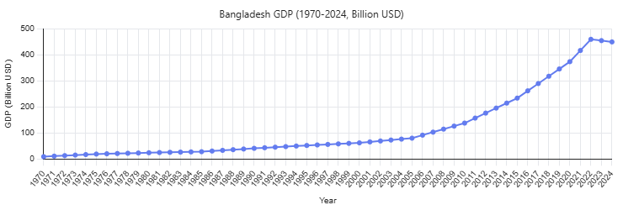

Slide 12
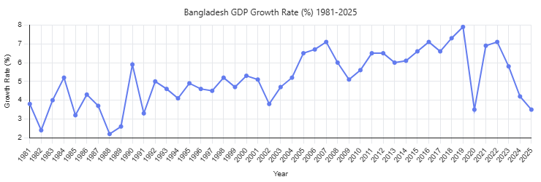

Slide 13
GDP and its Key Element
Market value of all final goods and services produced within a country during a given period.
Key Elements of GDP
Market value
Final goods and services
Produced within national borders
Specific time period

Slide 14
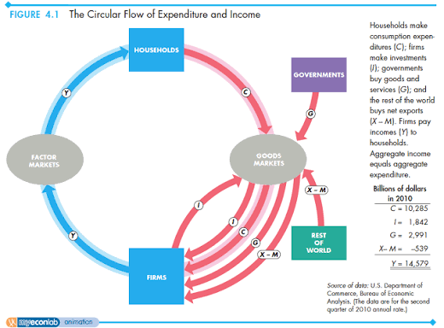
Circular Flow and GDP

Slide 15
Circular Flow and GDP
Households
  Supply factors of production
  Receive income
Firms
  Produce goods and services
  Pay wages, rent, interest, profit
Flow
Production → Income → Expenditure → Production
Important identity
Total Production = Total Income = Total Expenditure

Slide 16
Measuring GDP: Expenditure Approach
GDP = C + I + G + (X − M)
C = Consumption
  Household spending on durable goods, nondurable goods, and services.
I = Investment
  Business fixed investment
  Residential construction
  Inventory investment
G = Government Purchases
  Spending by all levels of government on goods and services.
  Transfer payments excluded.
X−M = Net Exports

Slide 17
Calculation of GDP: Expenditure Approach
Component | Tk. Billion
Consumption | 700
Investment | 200
Government Spending | 150
Exports | 100
Imports | 50

Slide 18
Measuring GDP Using Income Approach
Income Type | Examples
Wages | Salaries
Rent | Property income
Interest | Loans
Profit | Business earnings
GDP can also be measured by summing incomes earned.
Formula:
GDP = Wages + Rent + Interest + Profit + Indirect Taxes + Depreciation

Slide 19
Calculation of GDP: Income Approach
Component | Tk. Billion
Wages | 500
Rent | 80
Interest | 70
Profit | 200
Depreciation | 100
Taxes less Subsidies | 50

